Slide 1
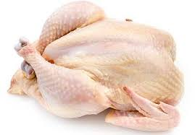
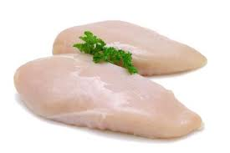
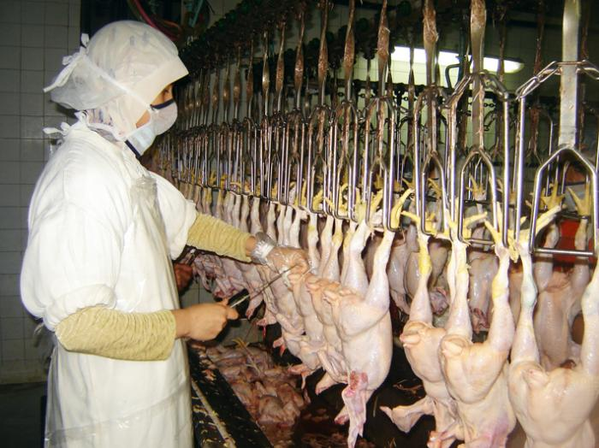
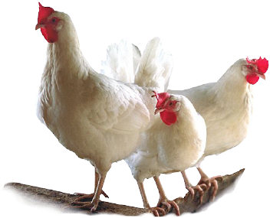

Slide 2
Poultry meat and slaughterhouse

Slide 3
introduction
Poultry refers to live / dressed domestic birds which have been bred for edible purposes& includes; chicken, ducks, geese & turkeys.
Poultry meat is the muscle tissue, skin, C.T& edible organs of avian spp,that usually used for food
30–40 days chicken weight of 2.5 kg or more.
The white (breast) meat of poultry contains about 1% fat and this rises to 3% in the dark (leg) meat
Poultry skin contains 33% fat, and the subdermal layers even higher amounts.

Slide 4
duck | medium fat turkey | chickens
 |  | hen | Roaster | Broiler
 | 58% | 56% | 66% | 71% | Water
16.1% |  |  | 20.2 | 20.5 | portions
28.6% | 20.2 |  | 12.6 | 2.7 | Fat content

Slide 5
Broiler: 7-8 weeks aged domestic fowl .
Capons: 15-16 weeks old , neutered males , sold for Christmas.
Turkey: 2k, 8-16 kg , traditional Christmas dish.
Ducks: traditionally reared on a free range system, now reared under intensive systems .

Slide 6
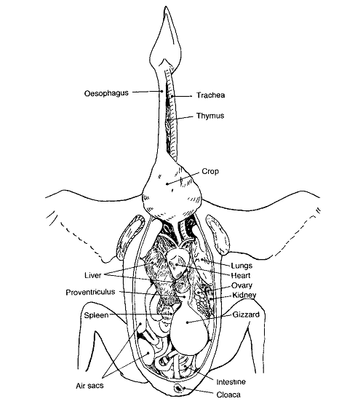
Avian anatomy

Slide 8
Construction & layout of an approved poultry Slaughter plant

Slide 9
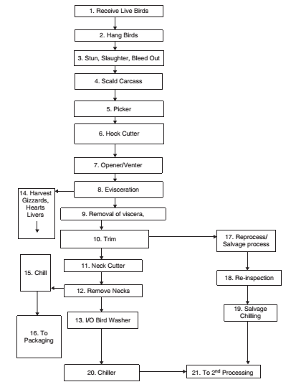

Slide 10
Technical aspects of slaughtering & dressing
At the farm:
1- drug withdrowal:7 d. before slaughter
2-starving 20-8 hr
3- water withdrowal 1hr before loading
4- (4-5 birds)/ crates. Caught from legs gently.
b. At the slaughter plant:
Unloading
Stunning &slaughtering
Plucking(defeathering)
Evisceration
Giblets
Cooling
Air chilling methods
Water chilling method.

Slide 11
Catching, Crating and Unloading
6-10 h
plastic crates, about 10 birds per cage
individually hung upside down by the feet on shackles suspended from a continuously moving line.
135 birds per minute.
Ante-mortem inspection is carried out in this area.

Slide 12
Ante-mortem inspection
نور کافی
شناسایی صدمات فیزیکی، عوارض بیماری ها، تلفات
حذف طیور موارد بیمار

Slide 13
Stunning
The head of the bird sinks into a salt solution
where they receive an electric shock of 120–150 V for a few seconds.
Each bird have optimal voltage and current

Slide 14
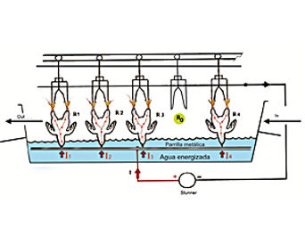

Slide 15
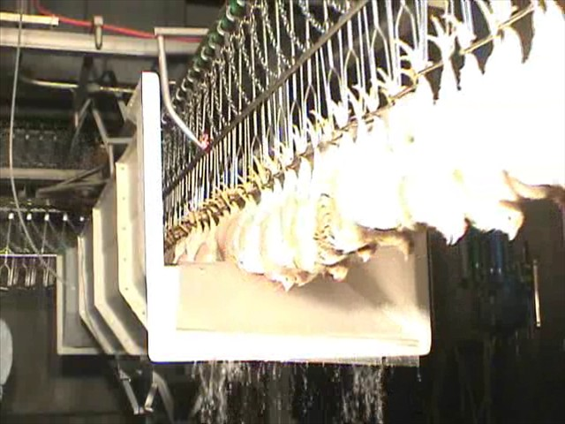

Slide 16
Bleeding
About 15-30 seconds after stunners
jugular veins and carotid arteries at the base of the skull
The birds now pass along a bleeding tunnel for at least 90 seconds for domestic fowls
50% of the blood

Slide 17
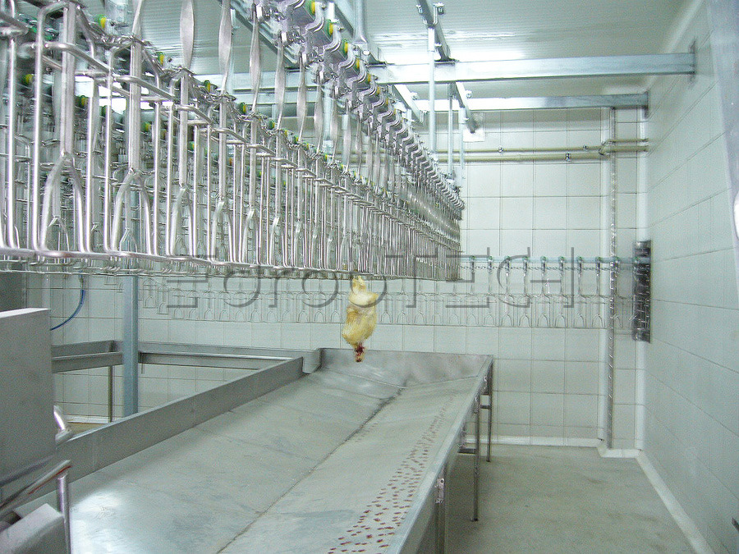

Slide 18
Scalding
The birds pass through the scalder
50-51°C for 3.5 min (soft scald) (fresh meat)
56-58 °C for 2-2.5 min (hard scald) (freezing)
Salmonella & campylobacter
Higher times and temperatures result in torn and discoloured skins.
The scalding loosens the feathers for the defeathering process.

Slide 19
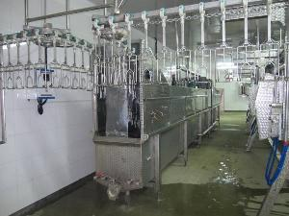
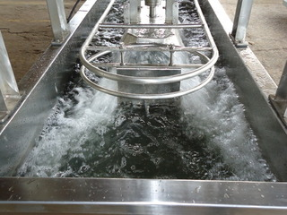

Slide 20
Plucking
plucking machine
Close to the scalder
This consists of a rotating plate and rubber ‘fingers’ that scrape the feathers of the epidermis off.
Adjust to the bird size
Cross contamination: scratch skin
Finally, the birds are washed.

Slide 21
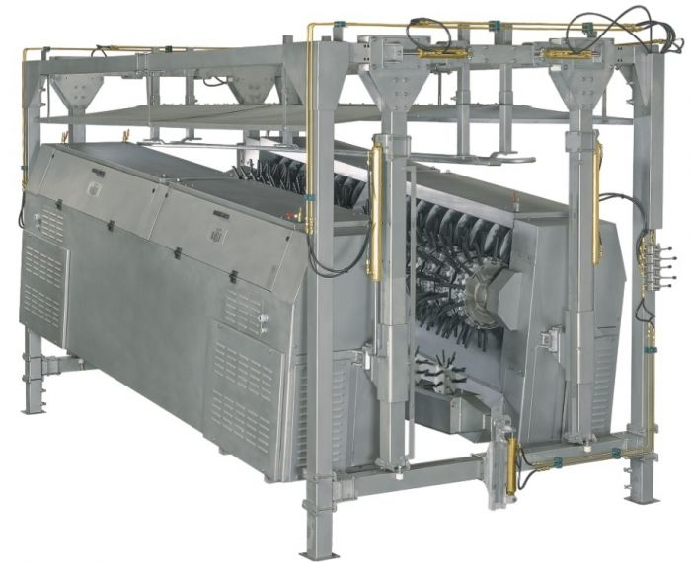
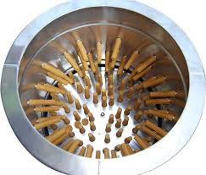

Slide 22
Whole bird post-mortem examination
Badly bled
emaciated birds
birds with septic wounds, etc.
are taken off the line before they can pass through into the ‘clean’ section of the slaughterhouse.

Slide 23
Neck slitting and foot removal
A vertical incision is made in the skin on the dorsal surface of the neck to assist in the removal of the crop, oesophagus and trachea at a later stage.
The feet are removed automatically

Slide 24
Evisceration
The evisceration line runs above a water trough or a mechanical conveyor
Various operations:
Venting.
Drawing.
Removal of offal
Head removal.
Neck removal.
Line washing.

Slide 25
Evisceration line
(1) Venting:
the vent is cut round so that it can be removed with the intestines from the carcass.
faecal contamination of the carcass edible offal and operators’ hands is to be avoided.

Slide 26
Evisceration line
(2) Drawing:
All of the viscera are drawn out of the body cavity
leaving them hanging from the carcass ready for inspection.

Slide 27
Evisceration line
(3) Removal of offal: The edible offal ; heart, liver and gizzard, are removed for further cleaning and washing.
The intestines, proventriculus and lungs are discarded into the water trough or mechanical conveyor.

Slide 29
Evisceration line
(4) Head removal.
This also removes the crop, oesophagus and trachea.
(5) Neck removal. The necks are removed by cutting through the vertebrae between the shoulders
(6) Line washing. remove blood and extraneous matter.

Slide 30
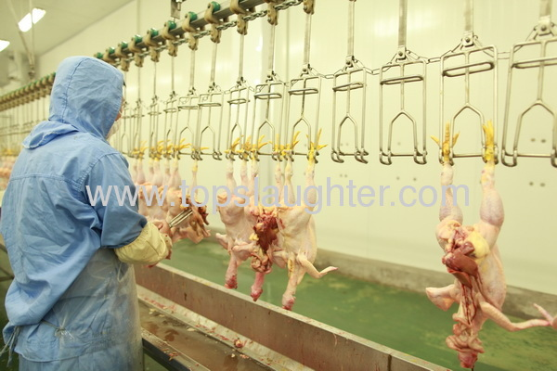

Slide 31
Cooling/chilling
main objective of the chilling process is to reduce the microbial load of the raw material and to maximize the shelf life and safety of the products.
cold air (commonly used in Europe) refrigerated chilling rooms for 1–3 h
immersion chilling in cold water (long chiller with a countercurrent flow of cold water) (30-60 min)
combination of cold air and water misting, so-called air spray chilling

Slide 32
Washing & immersion chilling
Washing:
long spin washer tanks, water10–16°C for 10 min.
The birds temperature of 36°C, exit at about 25°C.
Chlorination is used at a level of 50 ppm free chlorine
Chilling:
Flake ice, Some chillers are fed with refrigerated water. The birds remain in the chiller tank for 30–40 minutes and leave at a temperature of 2–4°C.
Draining: 10 min in chilling room

Slide 33
Poultry carcasses are often cut and deboned within 4–6 hours after slaughter and, thereafter,
further chilled in coolers. A high relative humidity in the cooler is recommended to reduce shrinkage due to evaporation from the product surface.

Slide 34
Post mortem inspection
(a) whole carcass inspection
immediately after defeathering and before any other operation. Badly bled or emaciated birds and birds with septic wounds, etc.
(b) evisceration inspection
(1200 broiler fowl per hour) the viscera, body cavity (including the forward air sacs), legs and carcass must be examined.
(c) final carcass inspection
This takes place after the viscera have been removed and the body cavity has been washed

Slide 35
Post mortem inspection
Unfit for human consumption:
Generalized infectious diseases and any localization of zoonotic microorganisms.
Extensive subcutaneous or muscular parasitism
Cachexia
Abnormal smell, color or taste
Malignant or multiple tumours
General spoiling or contamination
Major ecchymoses
Extensive mechanical lesion (over scalding)
Insufficient bleeding
Ascites

Slide 36
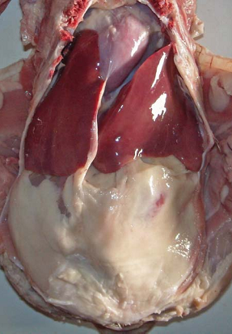

Slide 37
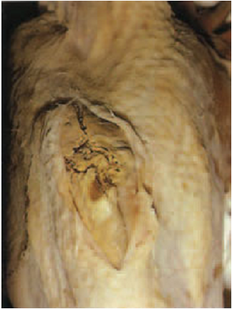
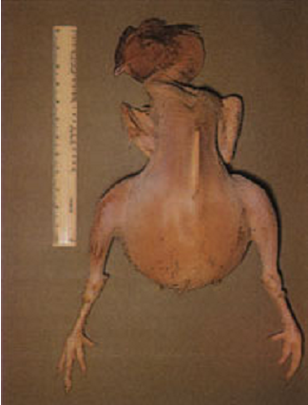

Slide 38
